Slide 1

Software Engineering
07: Software Process Models
Dr. Seyed Reza Shahamiri More Info

Slide 2

The Software Process
A software development process is a structured set of activities required to develop a software system.
Similar terms include Software Development Life Cycle (SDLC) and software process.
SDLC is essentially a series of steps, or phases, that provide a model for the development and lifecycle management of an application or piece of software.
The intent of a SDLC process is to help produce a product that is cost-efficient, effective, and of high quality.

Slide 3
The Software Process Fundamental Software Engineering Activities
There are many different software processes but all must include four activities that are fundamental to software engineering:
Specification: defining what the system should do
Design and implementation: defining the organization of the system and implementing the system
Validation: checking that it does what the customer wants
Evolution: changing the system in response to changing customer needs

Slide 4
The Software Process Fundamental Software Engineering Activities More Detailed Activities
1. Planning: Identify the system; identifies the scope (s) of the system, its requirements, background study, timescales / time frames / milestones.
2. Analysis: Detailed study of requirements identified in the planning phase; workout the pros and cons; feasibility study is done; all identified requirements should be realistically analysed; important features should be highlighted;
3. Design: Based on the user requirements, planning and the detailed analysis, the new system must be designed i.e. a blueprint of the system is created by designing the technical architecture.

Slide 5
The Software Process Fundamental Software Engineering Activities More Detailed Activities
4. Implementation: Actually implementing the designed system; writing software programs using software languages.
5. Testing: Checking whether the implemented software works according to specified requirements; fixing bugs/errors.
6. Maintenance: To ensure that the implemented system is properly functioning as per the requirements.

Slide 6
Plan-Driven vs. Agile Processes
6
Plan-driven processes are processes where all of the process activities are planned in advance and progress is measured against this plan.
In agile processes, planning is incremental and it is easier to change the process to reflect changing customer requirements.
In practice, most practical processes include elements of both plan-driven and agile approaches.
There are no right or wrong software processes.

Slide 7
Software Process Models
7
For the software development process, there are several models for this, each describing systematic approaches to a variety of tasks or activities that take place during the process.
Each of these models has its pros and cons, and it's up to the development team to adopt the most appropriate one for the project.

Slide 8
Generic Software Process Models
8
The waterfall model
Plan-driven model. Separate and distinct phases of specification and development.
Incremental development
Specification, development and validation are interleaved. May be plan-driven or agile.
Reuse-oriented software engineering
The system is assembled from existing components. May be plan-driven or agile.
In practice, most large systems are developed using a process that incorporates elements from all of these models.

Slide 9
Software Process Models 1. The Waterfall Model
9
The waterfall model is a linear-sequential design process. In this, progress is seen as flowing steadily downwards from the top (like a waterfall) through the development phases.
This is oldest, the most common, classic, simple to use and understand software engineering model.
In a waterfall model, each phase must be completed in its entirety before the next phase can begin.
At the end of each phase, a review takes place to determine if the project is on the right path and whether or not to continue or discard the project. However, phases do not overlap each other.

Slide 10
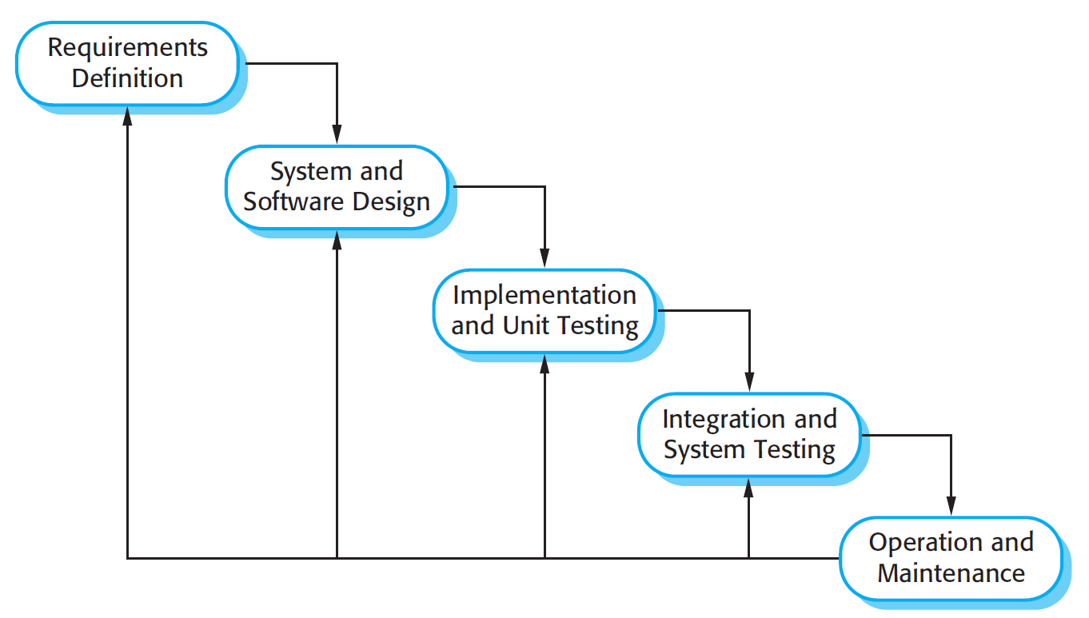
Software Process Models 1. The Waterfall Model
10

Slide 11
Software Process Models 1. The Waterfall Model Class Activity
11
Discuss the pros and cons of waterfall.

Slide 12
Software Process Models 1. The Waterfall Model Advantages
12
Simple to use and understand, easy to manage as phases are processed once at a time, very suitable for projects where the overall project requirements are very well understood.
The waterfall model is consistent with other engineering process models and documentation is produced at each phase.
This makes the process visible so managers can monitor progress against the development plan.

Slide 13
Software Process Models 1. The Waterfall Model Disadvantages
13
The essence of waterfall software development model is that complex software systems can be built in a sequential, phase-wise manner where:
All of the requirements are gathered at the beginning,
All of the design is completed next,
And finally the master design is implemented into production quality software.
Meaning that this approach holds that complex systems can be built in a single pass, without going back and revisiting requirements or design ideas in light of changing business or technology conditions.

Slide 14
Software Process Models 1. The Waterfall Model Disadvantages
14
However, in reality such a sequential approach is not a practical one and mostly leads to the failure of the project.
Why??
Because all “requirements cannot be gathered” right at the beginning and requirements constantly change during the project.

Slide 15
Software Process Models 1. The Waterfall Model Disadvantages
15
Nonetheless, being a strictly sequential model, jumping back and forth between two or more phases is not possible in Waterfall model.
The next phase can be reached only after the previous one has been completed.
Thus bugs and errors in the code cannot be discovered until and unless the testing phase is reached. This leads to a lot of wastage of time and other precious resources.

Slide 16
Software Process Models 1. The Waterfall Model Disadvantages
16
So, to summarize, the disadvantages are:
High amounts of risk and uncertainty.
Poor model for complex and object-oriented projects.
Poor model for long and ongoing projects.
Poor model where requirements are at a moderate to high risk of changing.
This process model is not suitable for projects wherein the project requirements are dynamic or constantly changing.

Slide 17
Software Process Models 1. The Waterfall Model Formal System Development
17
An important variant of the waterfall model is formal system development, where a mathematical model of a system specification is created.
Based on the assumption that your mathematical transformations are correct, you can therefore make a strong argument that a program generated in this way is consistent with its specification.
Formal development processes are particularly suited to the development of systems that have stringent safety, reliability, or security requirements.
Can be extremely difficult and/or expensive.

Slide 18



Software Process Models 2. Incremental Development
18

Slide 19
Software Process Models 2. Incremental Development
19
Incremental development is based on the idea of developing an initial implementation, exposing this to user comment and evolving it through several versions until an adequate system is developed.
Specification, development, and validation activities are interleaved rather than separate, with rapid feedback across activities.
By developing the software incrementally, it is cheaper and easier to make changes in the software as it is being developed.

Slide 20
Software Process Models 2. Incremental Development
20
Incremental development reflects the way that we solve problems:
We rarely work out a complete problem solution in advance but move toward a solution in a series of steps, backtracking when we realize that we have made a mistake.

Slide 21
Software Process Models 2. Incremental Development
21
Each increment or version of the system incorporates some of the functionality that is needed by the customer.
Generally, the early increments of the system include the most important or most urgently required functionality.
This means that the customer can evaluate the system at a relatively early stage in the development to see if it delivers what is required.

Slide 22
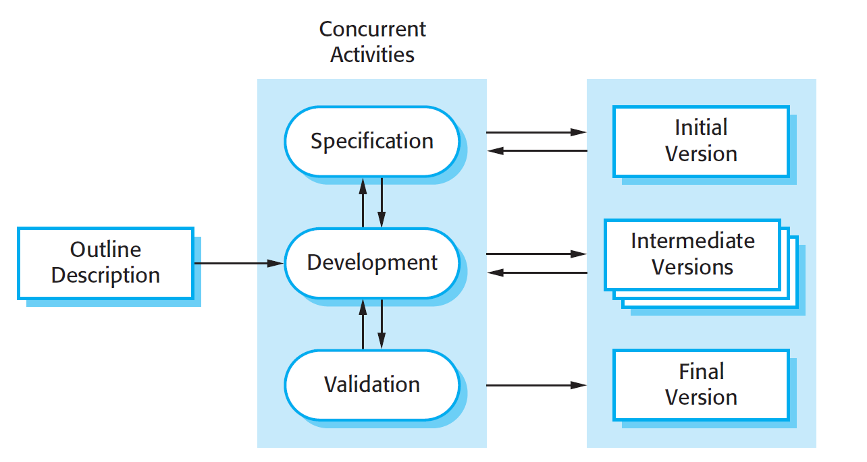
Software Process Models 2. Incremental Development
22

Slide 23
Software Process Models 2. Incremental Development Class Activity
23
Analyse the incremental development approach to software development and discuss its pros and cons.
Also discuss what kinds of software projects are more and/or less suitable to be developed by this process model.

Slide 24
Software Process Models 2. Incremental Development Advantages
24
The cost of accommodating changing customer requirements is reduced.
The amount of analysis and documentation that has to be redone is much less than is required with the waterfall model.
It is easier to get customer feedback on the development work that has been done.
Customers can comment on demonstrations of the software and see how much has been implemented.

Slide 25
Software Process Models 2. Incremental Development Advantages
25
More rapid delivery and deployment of useful software to the customer is possible.
Customers are able to use and gain value from the software earlier than is possible with a waterfall process.

Slide 26
Software Process Models 2. Incremental Development Disadvantages
26
From a management perspective, the incremental approach has two problems:
The process is not visible.
Managers need regular deliverables to measure progress. If systems are developed quickly, it is not cost-effective to produce documents that reflect every version of the system.
System structure tends to degrade as new increments are added.
Unless time and money is spent on refactoring to improve the software, regular change tends to corrupt its structure. Incorporating further software changes becomes increasingly difficult and costly.

Slide 27
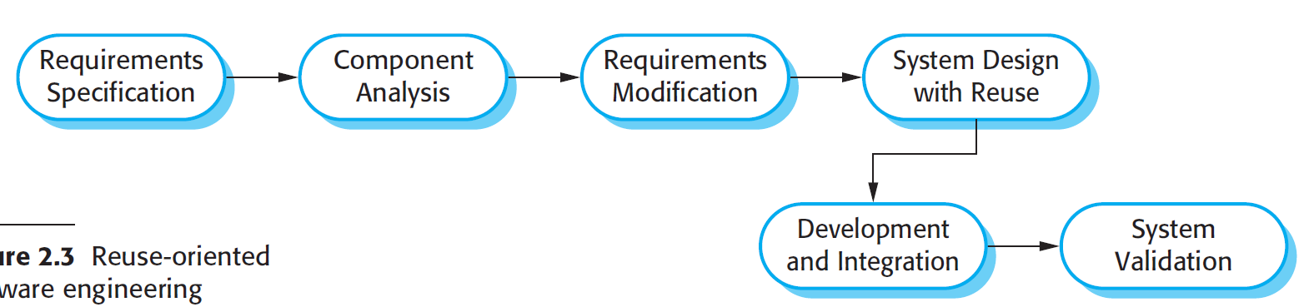
Software Process Models 3. Reuse-Oriented Software Engineering
27
Based on systematic reuse where systems are integrated from existing components or COTS (Commercial-off-the-shelf) systems.
Although the initial requirements specification stage and the validation stage are comparable with other software processes, the intermediate stages in a reuse-oriented process are different.

Slide 28
Software Process Models 3. Reuse-Oriented Software Engineering Stages
28
These intermediate stages are:
Component analysis: Search for the available components that reflect requirements. Usually, there is no exact match and the components that may be used only provide some of the functionalities required.
Requirements modification: Requirements are then modified to reflect the available components. Where modifications are impossible, the component analysis activity may be re-entered to search for alternative solutions.

Slide 29
Software Process Models 3. Reuse-Oriented Software Engineering Stages
29
3. System design with reuse: During this phase, the framework of the system is designed or an existing framework is reused. Some new software components may have to be designed if reusable components are not available.
4. Development and integration: Software that cannot be externally procured is developed, and the components and COTS systems are integrated to create the new system.

Slide 30
Software Process Models 3. Reuse-Oriented Software Engineering Types of software component
30
There are three types of software components that may be used in a reuse-oriented process:
Web services that are developed according to service standards and which are available for remote invocation.
Collections of objects that are developed as a package to be integrated with a component framework such as .NET or J2EE.
Stand-alone software systems (COTS) that are configured for use in a particular environment.

Slide 31
Coping with change
31
Change is inevitable in all large software projects:
Business changes lead to new and changed system requirements.
New technologies open up new possibilities for improving implementations.
Changing platforms require application changes.
Change leads to rework so the costs of change include both rework (e.g. re-analyzing requirements) as well as the costs of implementing new functionality.

Slide 32
Reducing the costs of rework
32
Change avoidance, where the software process includes activities that can anticipate possible changes before significant rework is required.
For example, a prototype system may be developed to show some key features of the system to customers.
Change tolerance, where the process is designed so that changes can be accommodated at relatively low cost.

Slide 33
Reducing the costs of rework Change tolerance
33
Change tolerance normally involves some form of incremental development.
Proposed changes may be implemented in increments that have not yet been developed.
If this is impossible, then only a single increment (a small part of the system) may have be altered to incorporate the change.

Slide 34
Software Process Models to Cope with Changes 1. Software Prototyping
34
A prototype is an initial version of a system used to demonstrate concepts and try out design options.
A prototype can be used in:
The requirements engineering process to help with requirements elicitation and validation
In design processes to explore options and develop a UI design
In the testing process to run back-to-back tests.

Slide 35
Software Process Models to Cope with Changes 1. Software Prototyping Benefits of prototyping
35
Improved system usability.
A closer match to users’ real needs.
Improved design quality.
Improved maintainability.
Reduced development effort.

Slide 36
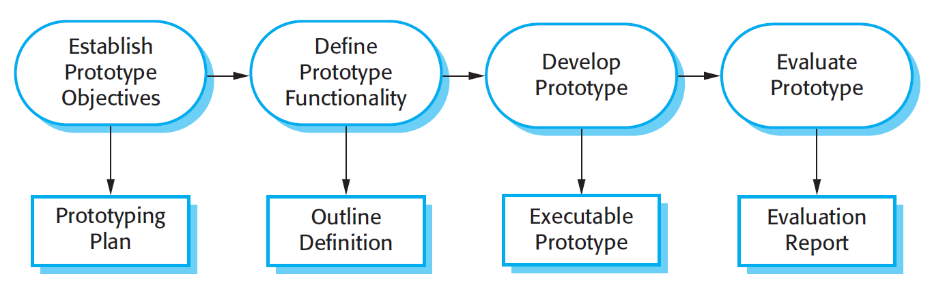
Software Process Models to Cope with Changes 1. Software Prototyping The process of prototype development
36

Slide 37
Software Process Models to Cope with Changes 1. Software Prototyping Throw-away prototypes
37
Prototypes should be discarded after development as they are not a good basis for a production system:
It may be impossible to tune the system to meet non-functional requirements
Prototypes are normally undocumented
The prototype structure is usually degraded through rapid change
The prototype probably will not meet normal organizational quality standards

Slide 38
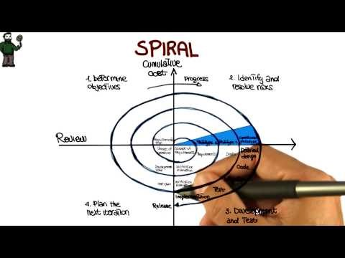
Software Process Models to Cope with Changes 2. Boehm’s spiral model
38

Slide 39
Software Process Models to Cope with Changes 2. Boehm’s spiral model
39
Process is represented as a spiral rather than as a sequence of activities with backtracking.
Each loop in the spiral represents a phase in the process.
The innermost loop might be concerned with system feasibility,
The next loop with requirements definition,
the next loop with system design,
and so on.
No fixed phases such as specification or design. Instead, loops in the spiral are chosen depending on what is required.
Risks are explicitly assessed and resolved throughout the process.

Slide 40
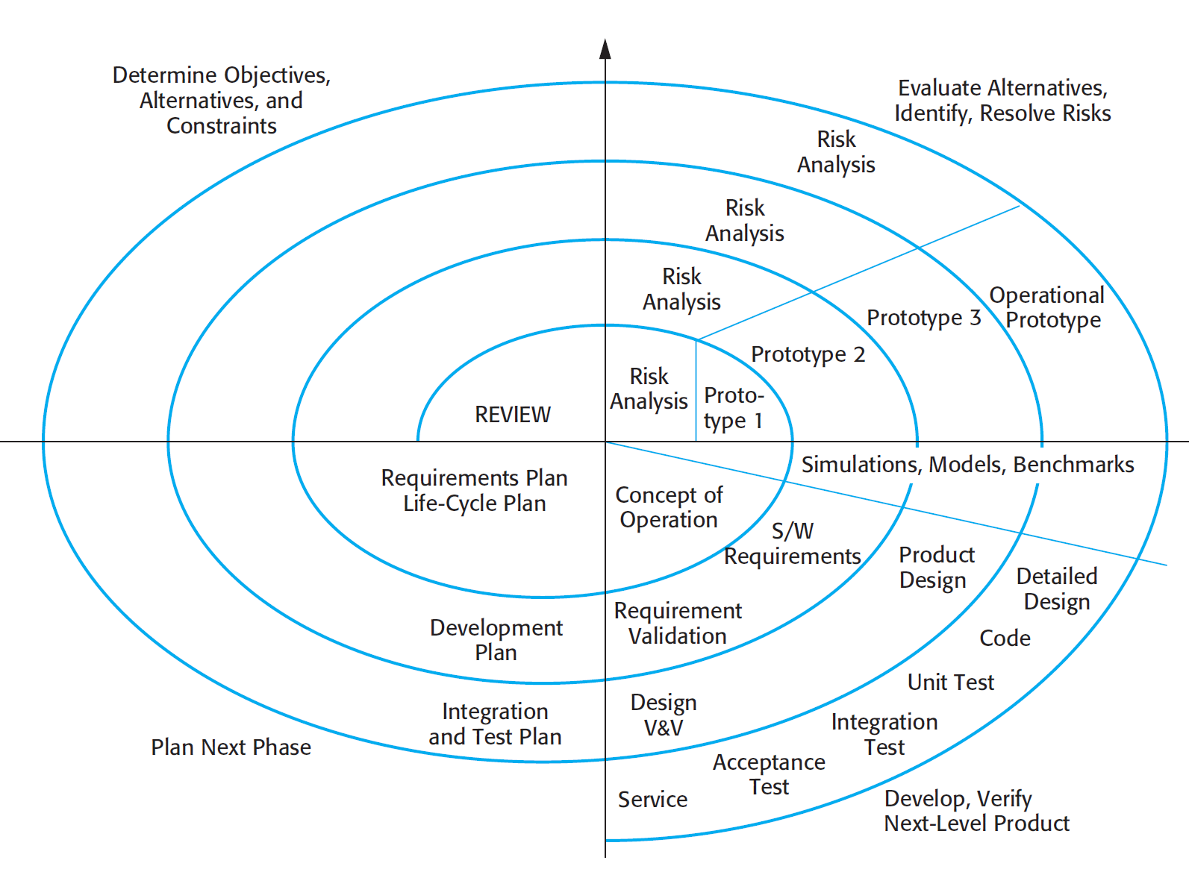
Software Process Models to Cope with Changes 2. Boehm’s spiral model
40

Slide 41
Software Process Models to Cope with Changes 2. Boehm’s spiral model Spiral model sectors
41
Each loop in the spiral is split into four sectors:
Objective setting
Specific objectives for the phase are identified.
Risk assessment and reduction
Risks are assessed and activities put in place to reduce the key risks.
Development and validation
A development model for the system is chosen which can be any of the generic models.
Planning
The project is reviewed and the next phase of the spiral is planned.

Slide 42
Software Process Models to Cope with Changes 2. Boehm’s spiral model Spiral model usage
42
Spiral model has been very influential in helping people think about iteration in software processes and introducing the risk-driven approach to development.
In practice, however, the model is rarely used as published for practical software development.

Slide 43
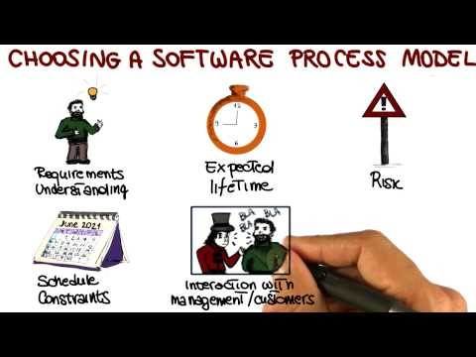
Software Process Models to Cope with Changes Choosing the right process model
43

